Slide 1

maxima and minima

Slide 2
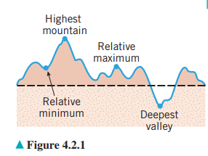
Relative maxima and minima

Slide 3
Critical Points
f ’(x)=0
Stationary Point
f ’(x)=undefined
Only Critical point

Slide 4
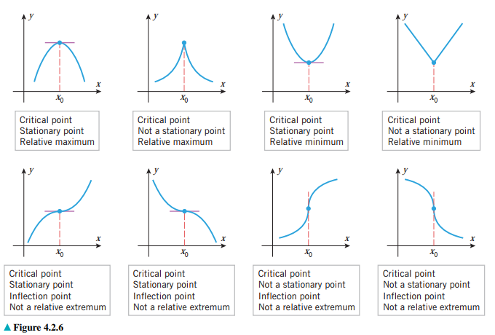

Slide 5
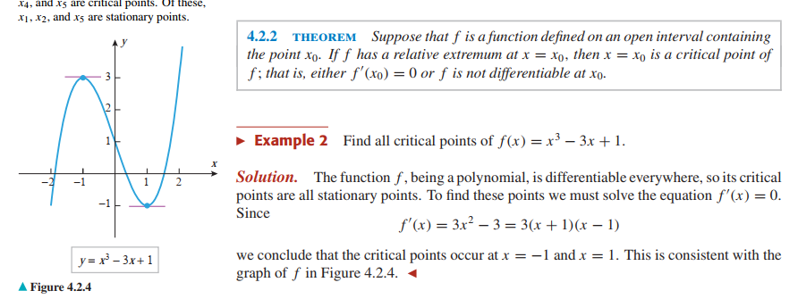

Slide 6
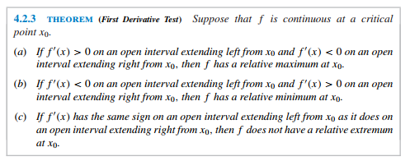
1st derivative test

Slide 7
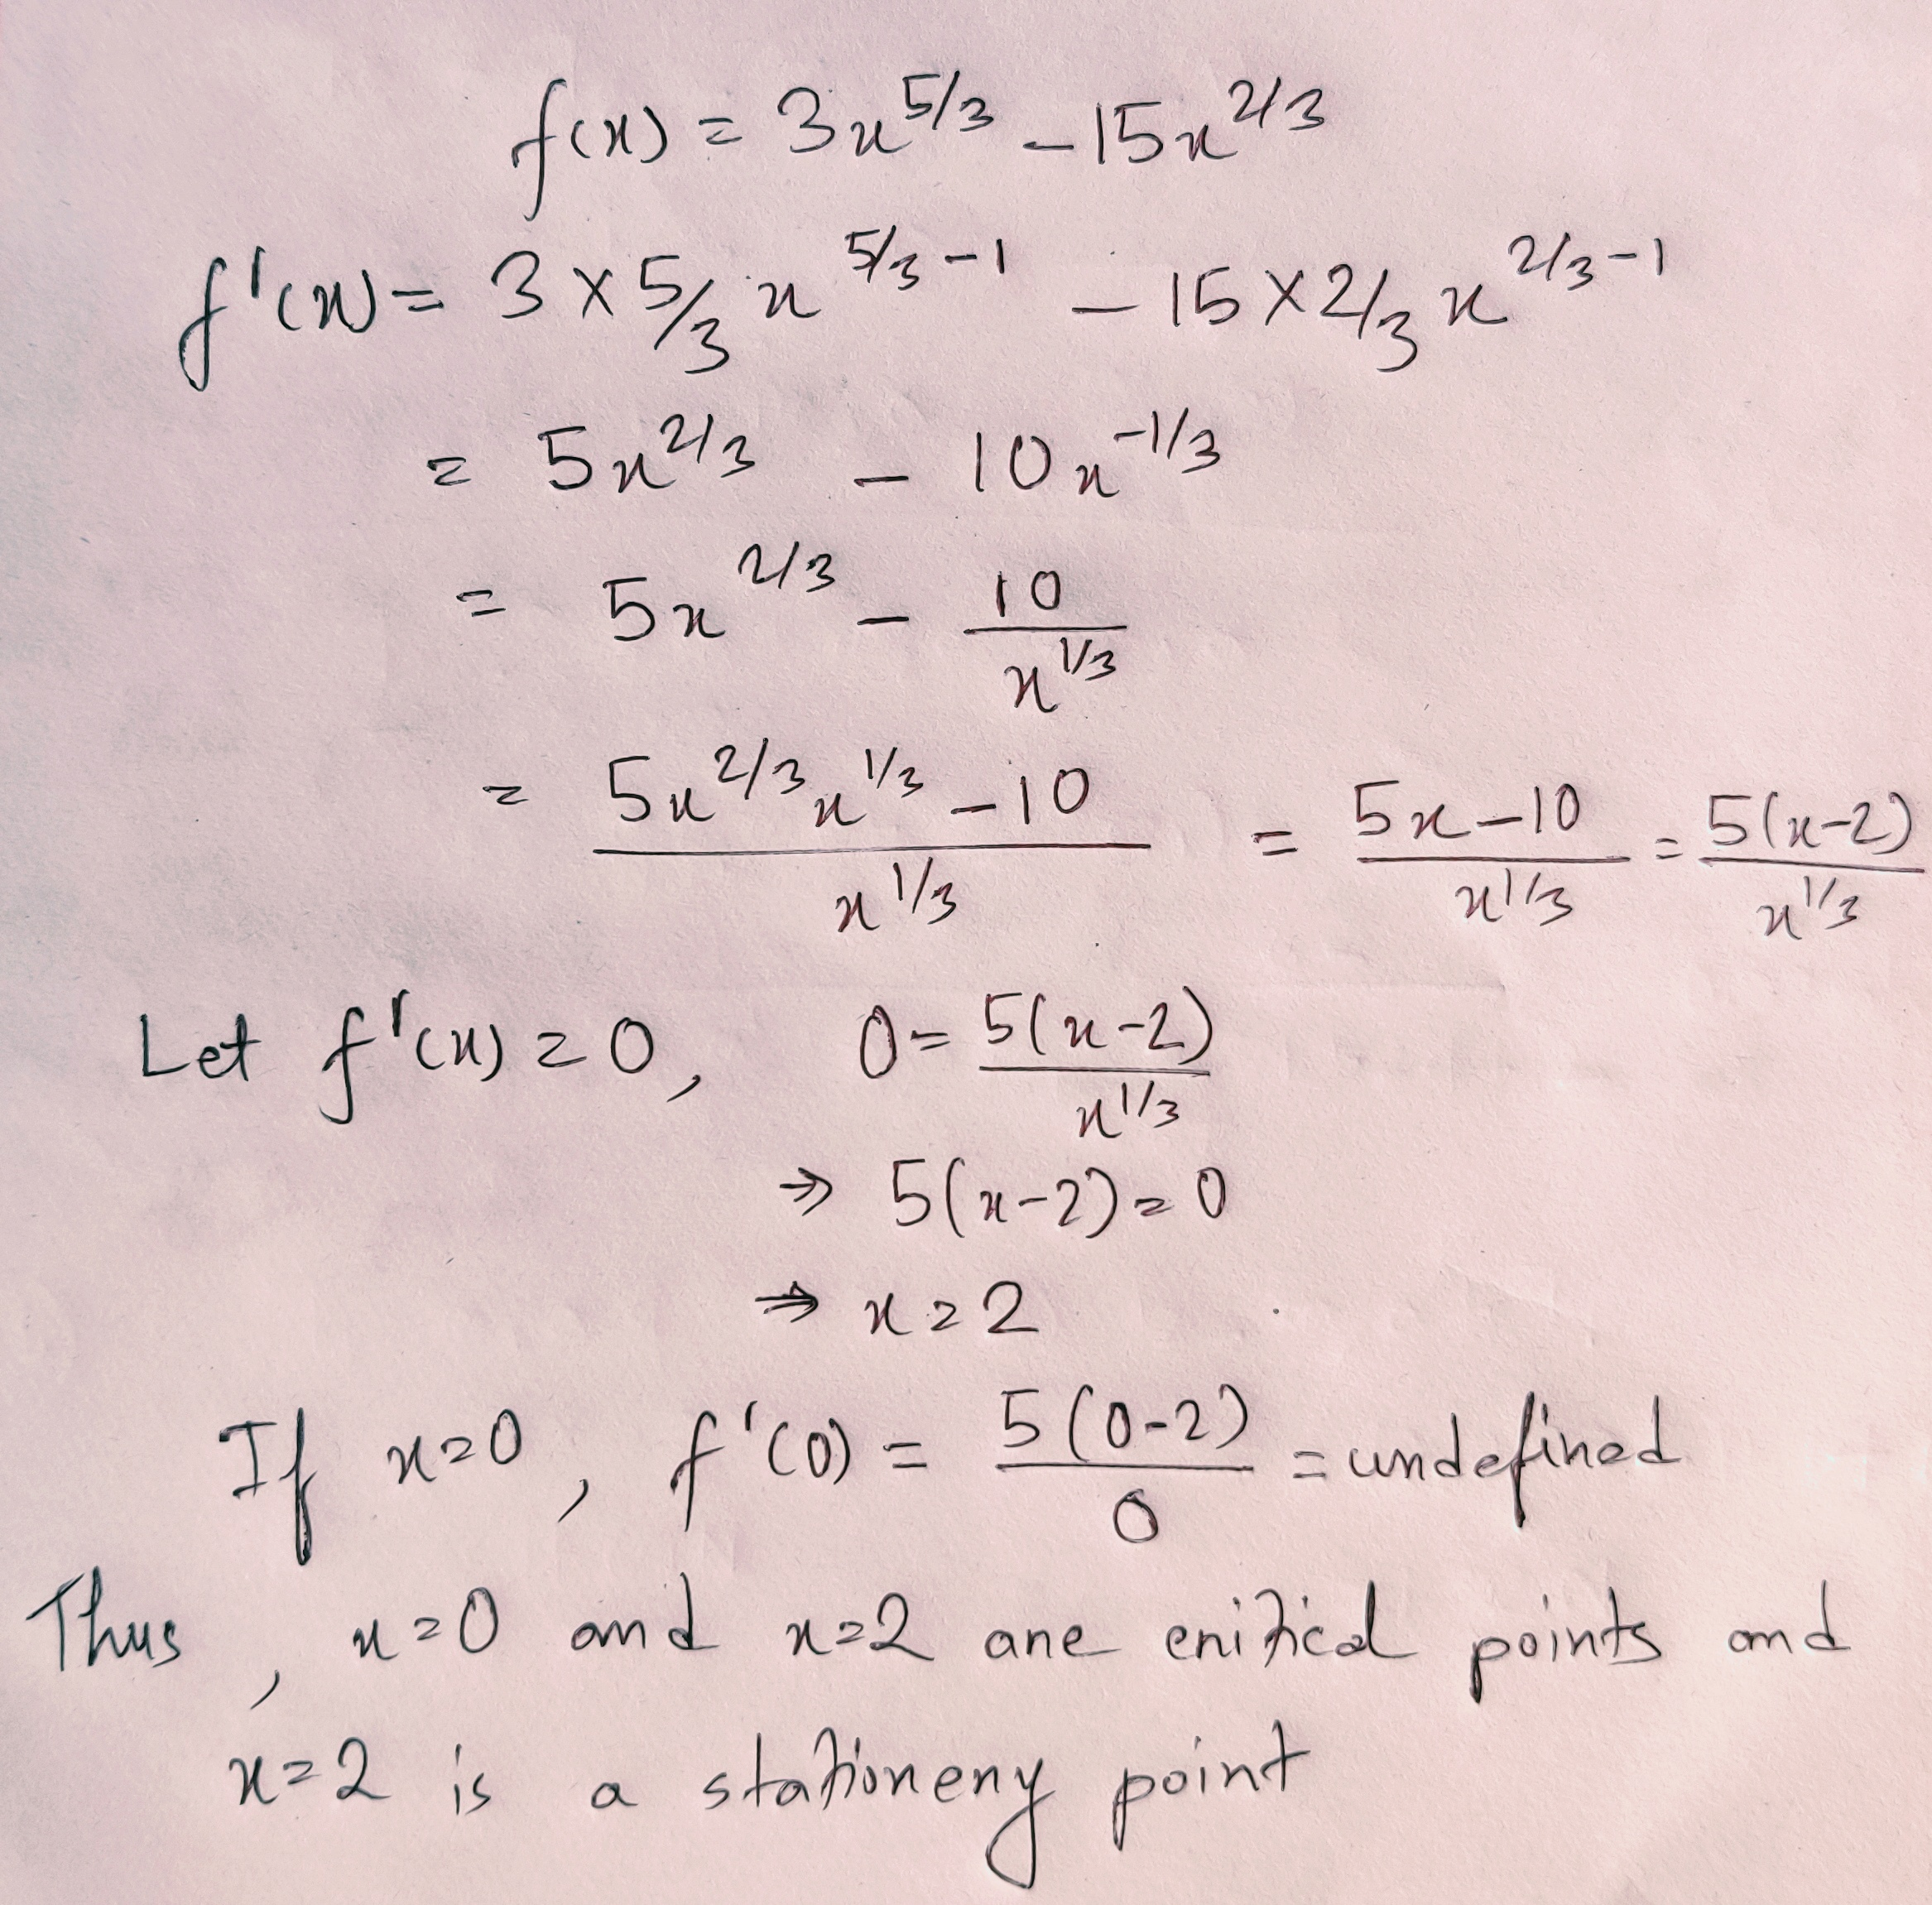

Slide 8
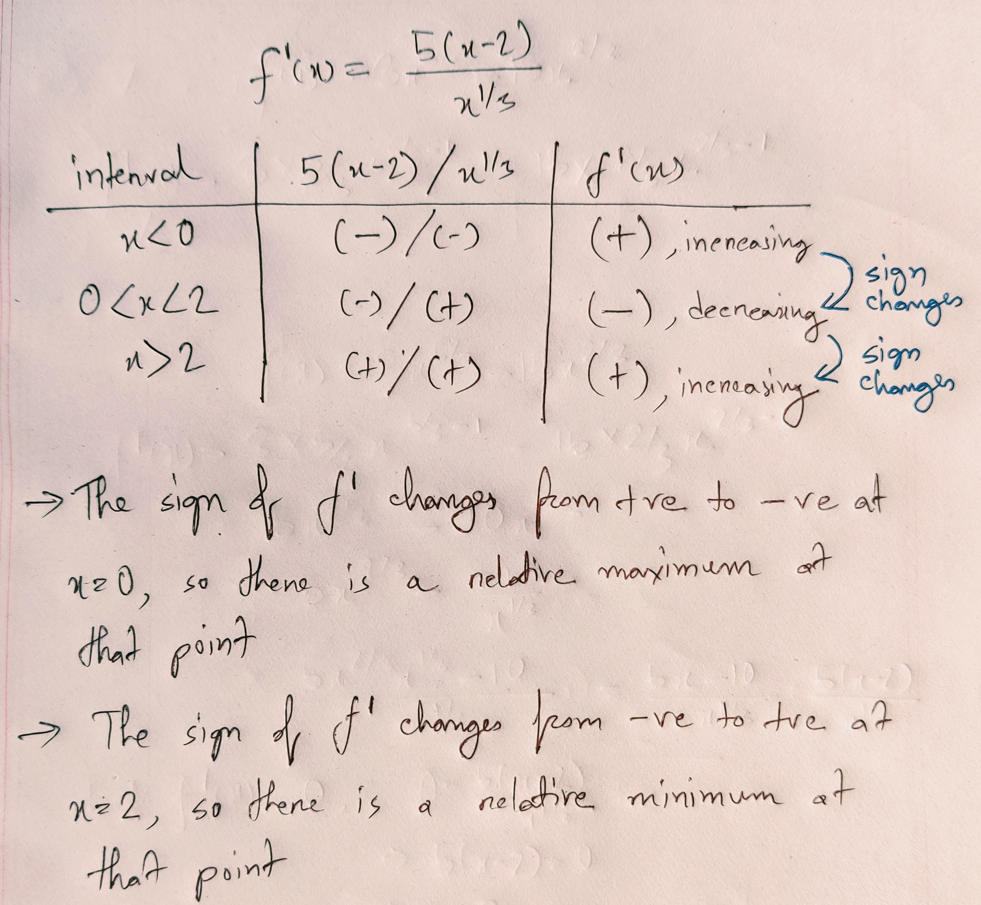

Slide 9
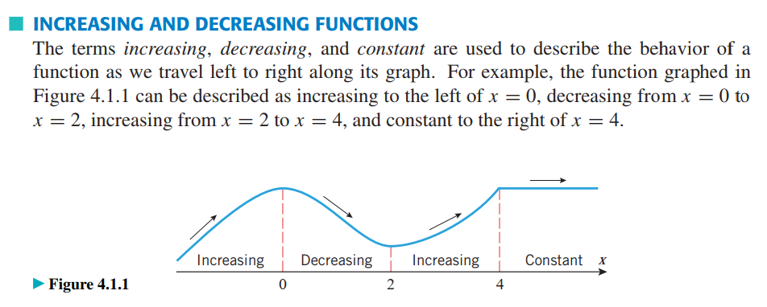

Slide 10
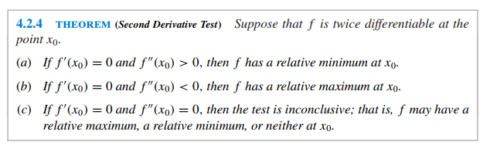
2nd derivative test

Slide 11
